Slide 1
Weekly report: Lesion feature clustering
01
Previously on last work
02
Lesion feature clustering
Lesion feature
Clustering
03
Summary

Slide 2
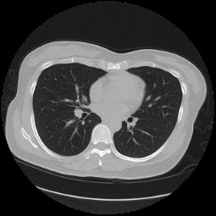
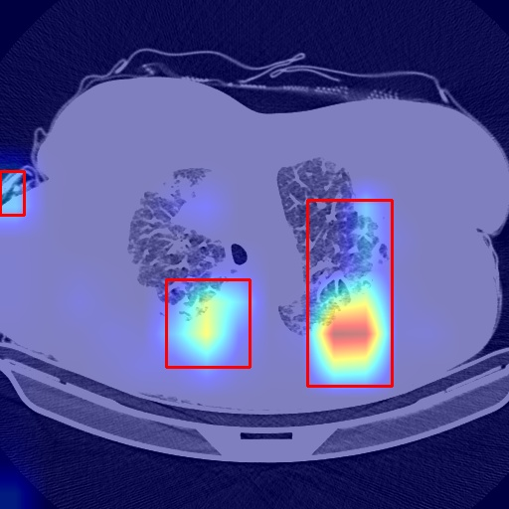
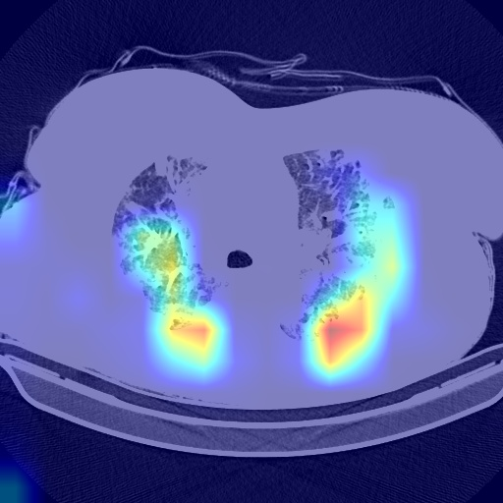
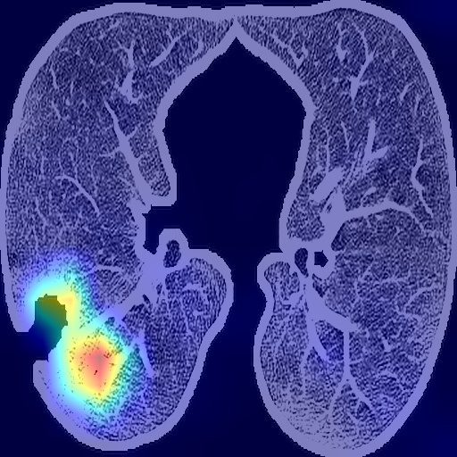
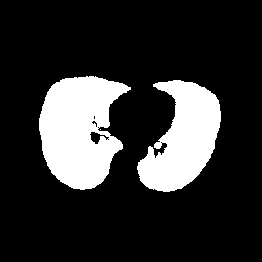
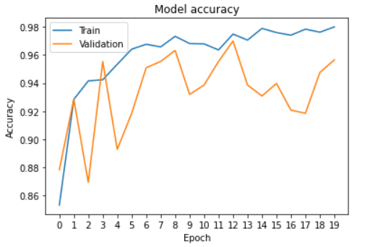
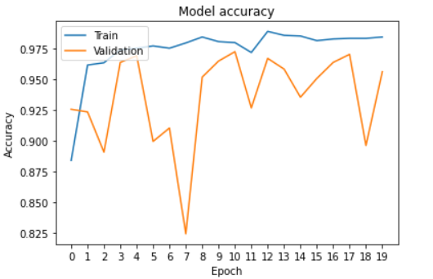
Optimization
*show the highlight region
with red boxes
CT image
Lesion
Draw boxes
CT sequence
CT slices
DL-model
Diagnosis
share with
Backbone’s weight
*The brighter the color,
The more important
the region.
Lung image
Lesion
Morphology
Train phase
localization phase
DL-model: Resnet + FPN + ensemble
Diagnosis: The reliability of localization depends on the diagnostic accuracy.
Draw boxes: Draw boxes that can cover the highlighted region
With lung region
With CT image

Slide 3
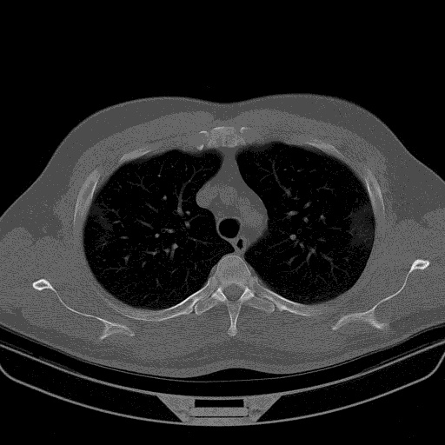
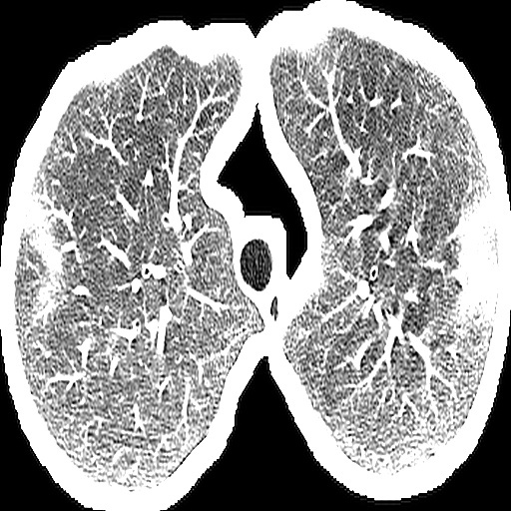
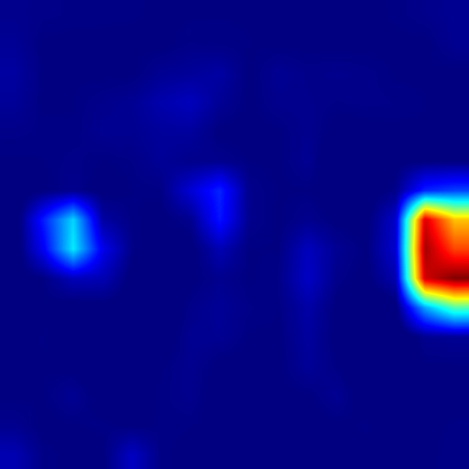
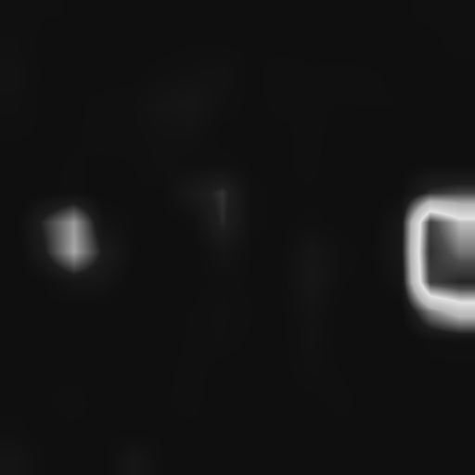
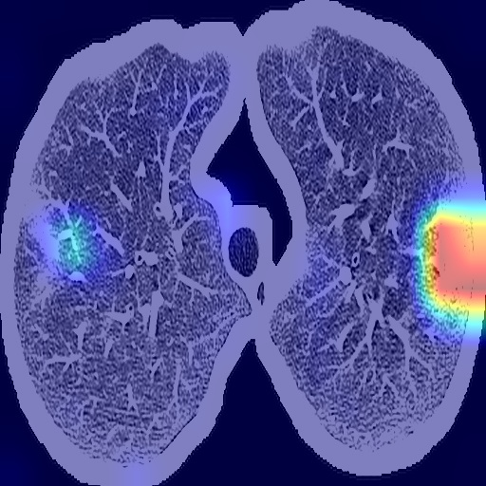
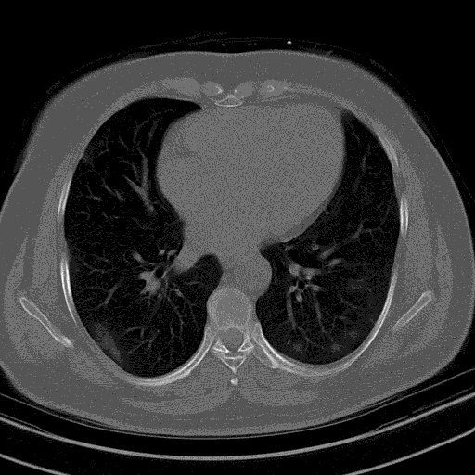
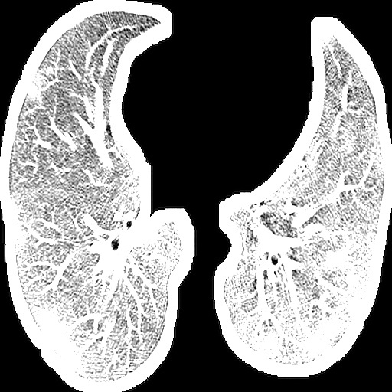
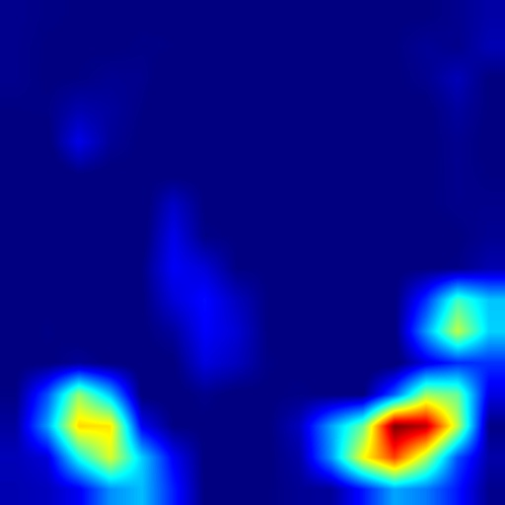
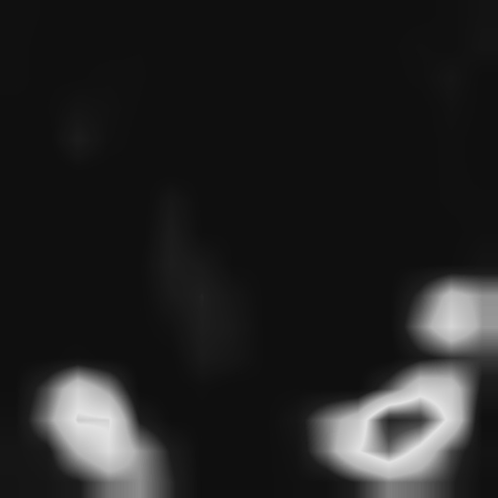
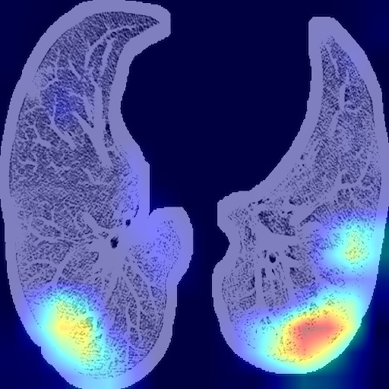
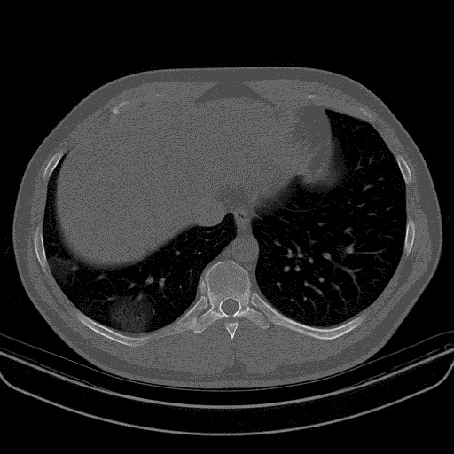
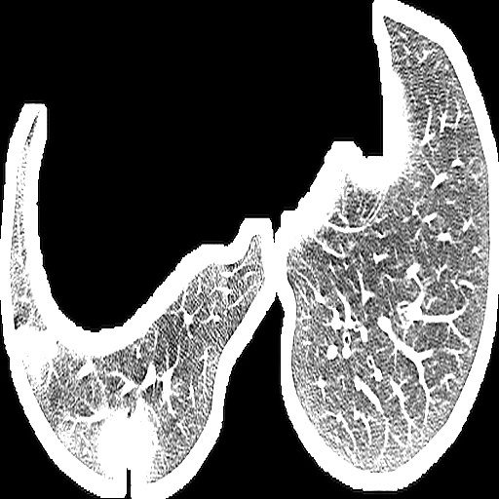
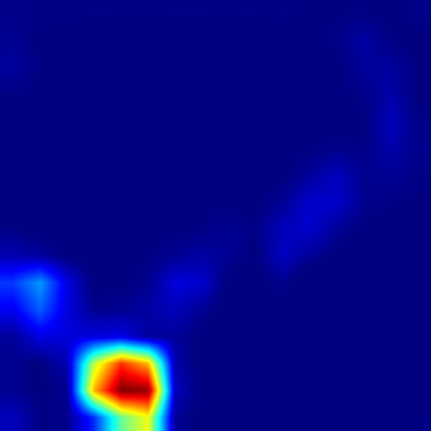
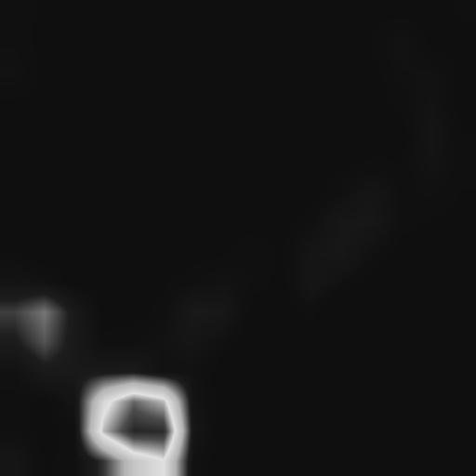
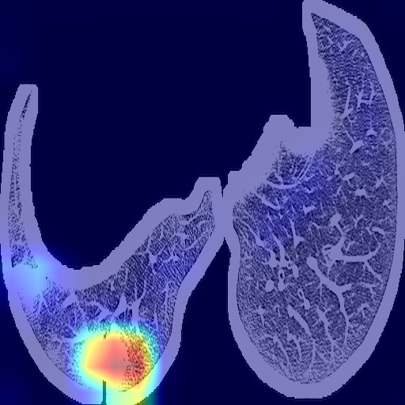
CT slice
Lung input
CAM
Gray CAM
Localization
[0.9999144,8.557419e-05]
[1.0,3.7869223e-09]
[0.9999144,8.557419e-05]
COVID Cases

Slide 4
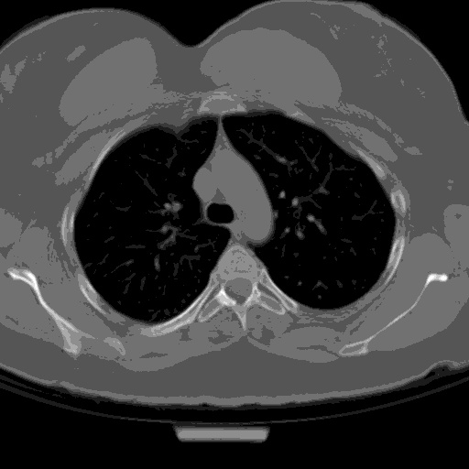
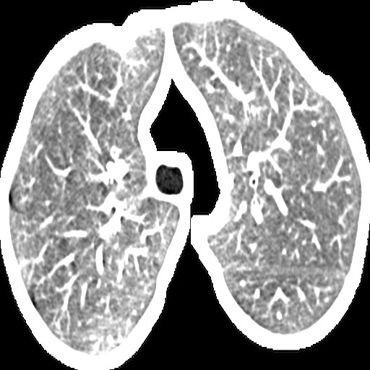
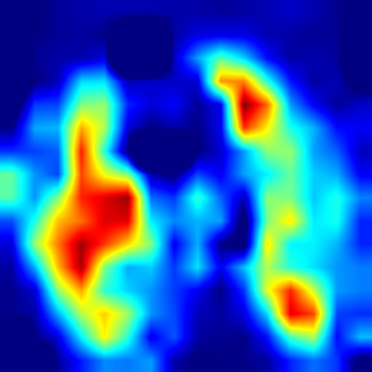
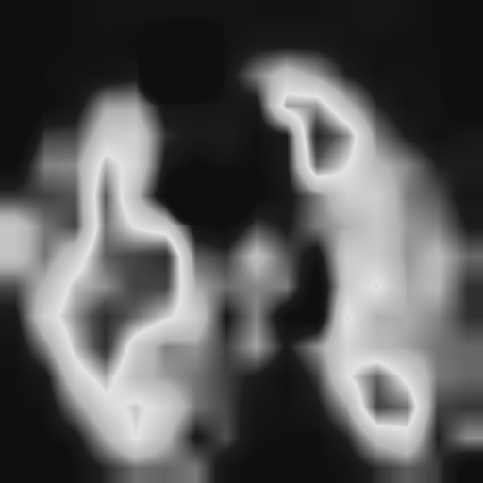
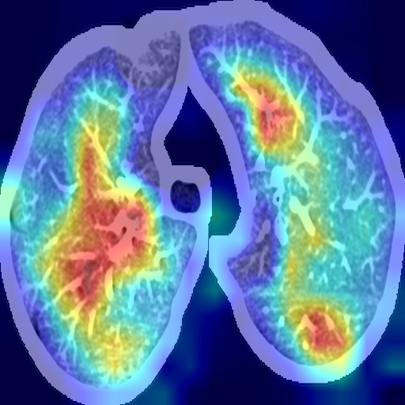
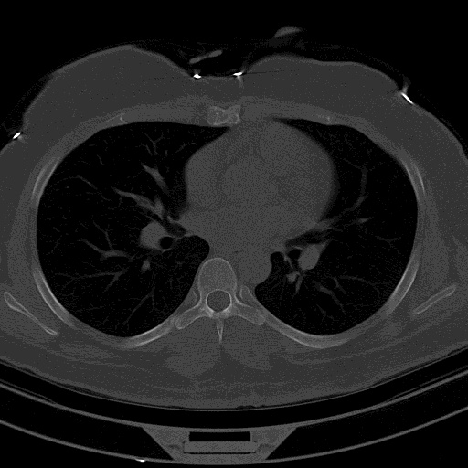
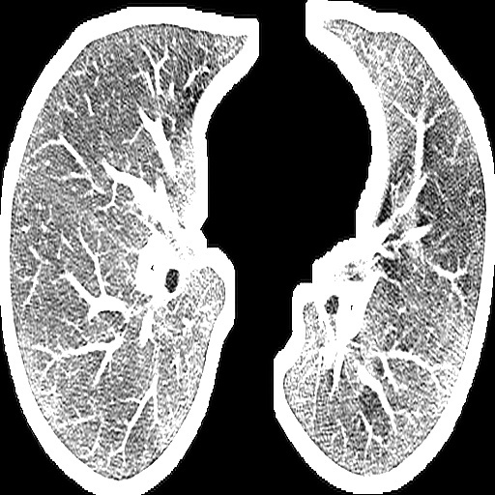
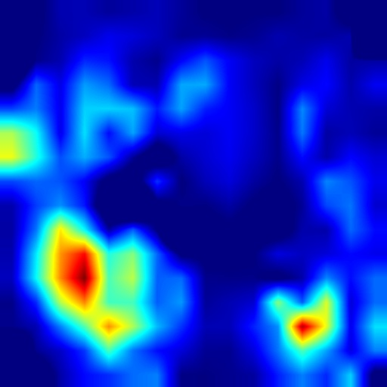
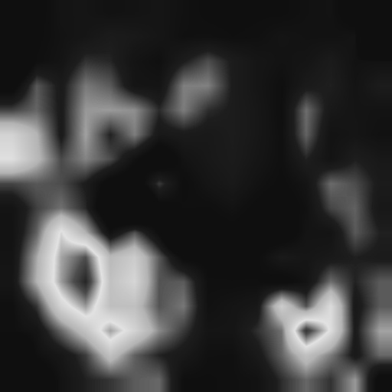
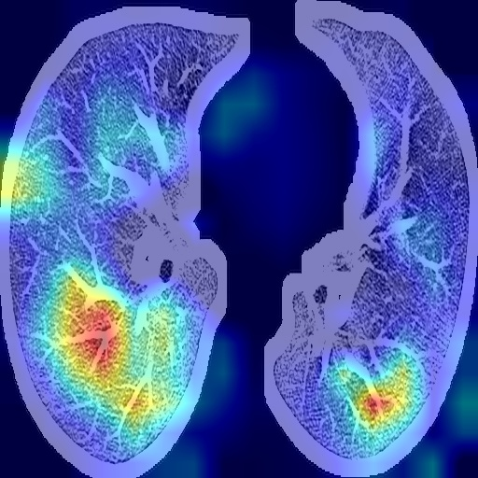
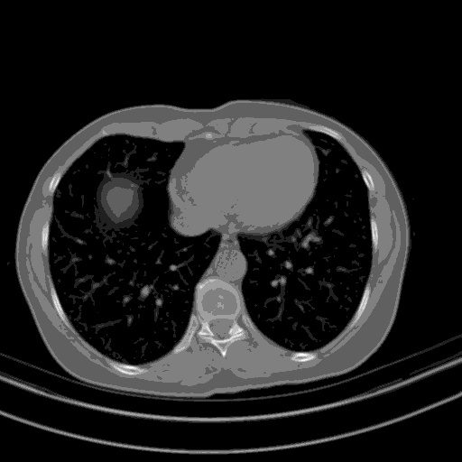
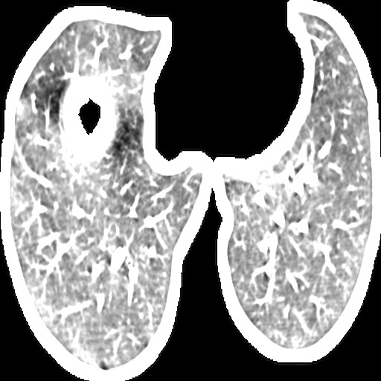
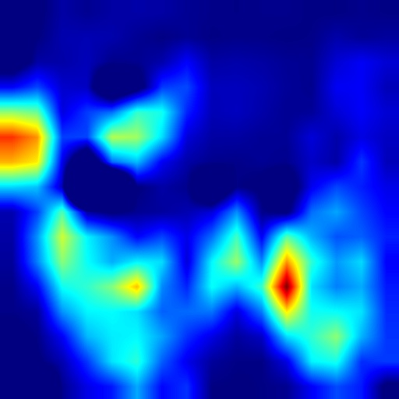
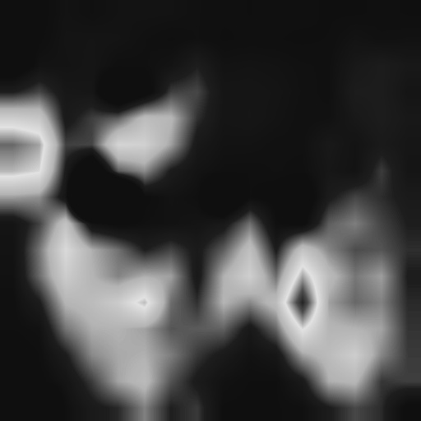
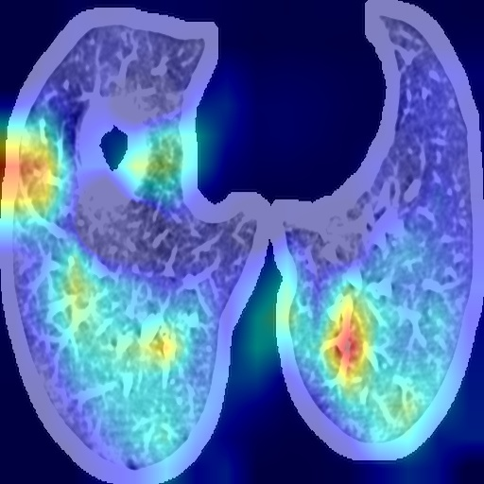
CT slice
Lung input
CAM
Gray CAM
Localization
[3.6236756e-06,0.9999964]
[4.757618e-05,0.99995244]
[2.2487338e-05,0.99997747]
NORMAL Cases

Slide 5
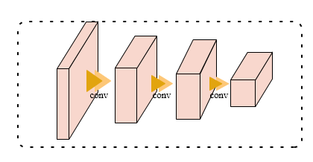
Lesion feature clustering
1. Lesion feature
Look at this
Input
DL-model
Flatten feature
Class score
[0.99617696 0.00382302]
Train phase
Classification
16×16×2048
1×2048
512×512
Resize
·
Gradient backprop
Localization
phase
16×16
16×16×2048
1×2048
CAM
512×512
Heat map (L)
Feature maps (A)
Gradient weight (W)
*
Remember that the higher the value of A(x, y), the higher the contribution of the local region corresponding to (x, y) to the prediction of the correct class label.

Slide 6
L
A
Feature vector
··
Lesion
Feature
2048
16×16
(x’, y’)
16×16×2048
1. locate the spatial maxima of L, (x’, y’) , This corresponds to points deemed maximally salient for the lesion localization task by the network.
2. Utilize spatial maxima of L, (x’, y’), extract corresponding feature of A as a local feature vector describing this maximally lesion region.
3. Repeat step 1&2 for each CT image, and then yield a set of feature vector, length of each feature vector is 2048.
2. Clustering
Target: clustering lesion feature of the 436 diagnosed cases to different group ( each group could be a type of lesion )
Method: Kmeans, which is a kind of self-supervised clustering method

Slide 7
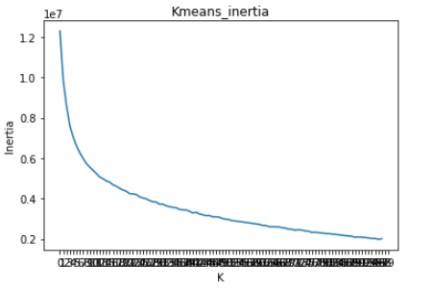
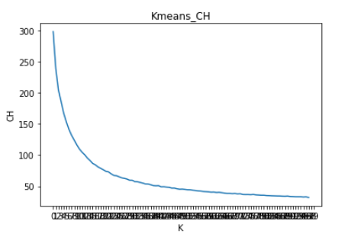
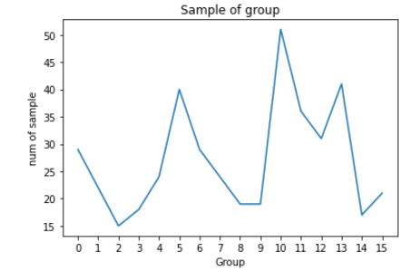
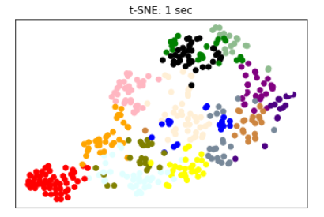
2.1 Determine K value, the number of group.
*inertia: Sum of squared distances of samples to their closest cluster center.
Elbow method
2.2 Clustering visualization
436 × 2048
High dimensional
sparse clustering
Each dot denotes a case, different color represent different clustering group.

Slide 8
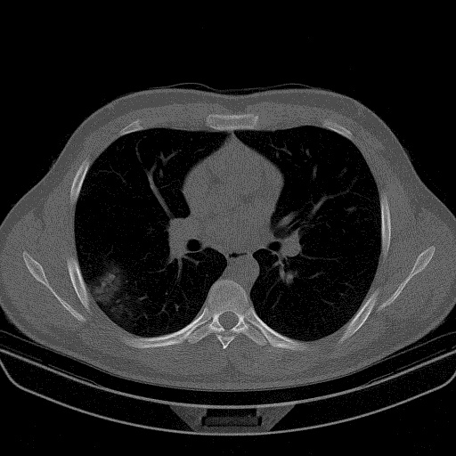
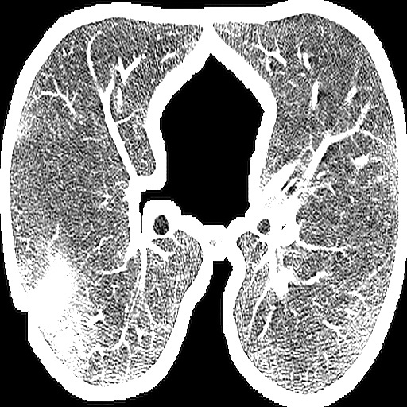
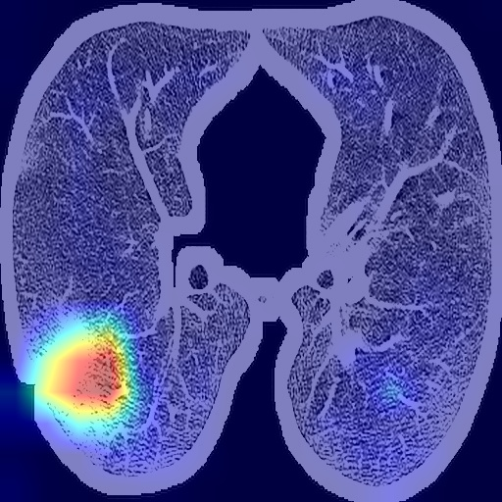
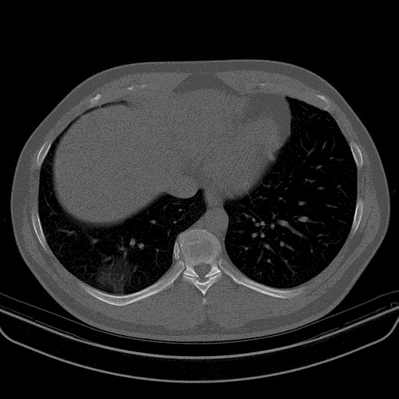
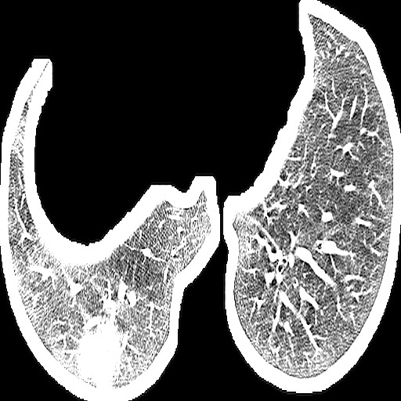
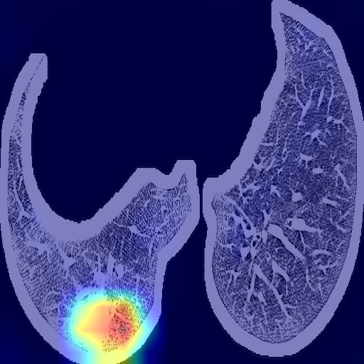
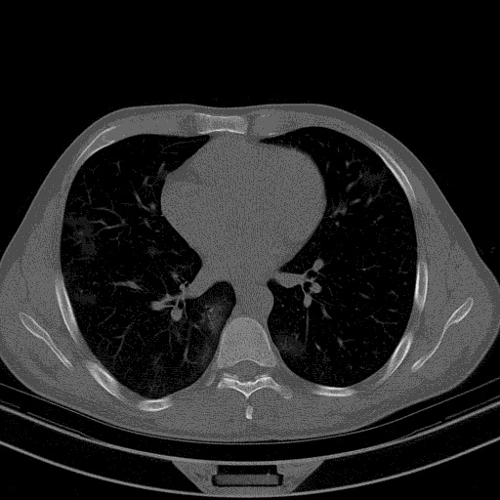
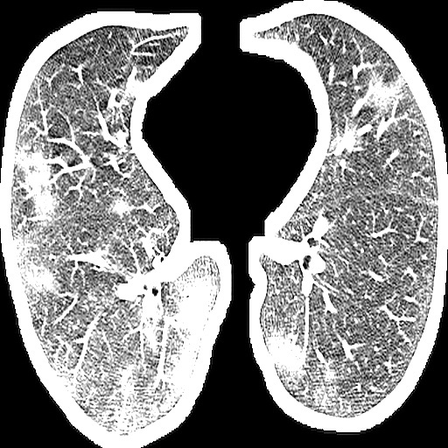







2.3 Case analysis
Group 1

Slide 9


















Group 13

Slide 10















2.4 Multi-lesion analysis
13
6,14
11,11,0

Slide 11
Summary
Contribution
A Deep learning model is designed. The backbone of which is rennet that paired with Feature Pyramid Network structure to extract features of different scales, the idea of ensemble learning is also embedded for enforcing the The expressiveness of different scale features. The proposed DL-model can achieve the state-of-art performance, the 98% accuracy of classifying COVID case and Normal cases.
Using the Weakly-supervised localization method, the lesion regions can be highlighted. Project the marked area to original CT image, it could help clinicians to fast focus on the suspected region , and make rapid diagnosis.
A pure data-driven lesion feature detector is developed. With this detector, the diverse lesion feature can extracted. Verified with basis self-supervised clustering method – Kmeans, the result shows that the COVID-related lesion feature can be extracted. According to the num of self-clustering, the detector has potential to detect the lesions that doesn’t report in clinical manifestation, which quite import in clinical treatment. This method is promising to be generalized to the lesion detection of other chest CT-based disease.

